Slide 1

Phylum – Mollusca
Prepared by
Dr. Rawa Abdul Redha Aziz
Ph.D Antibiotics/ Molecular biology
Dr. Hiba Shakir Ahmed
Ph.D Microbiology/Immunity

Slide 2
Phylum – Mollusca
Mollusca are the second largest animal phylum. They are terrestrial or aquatic.
They exhibit organ-system level of organization.
They are bilaterally symmetrical, triploblastic, coelomate animals. There is little segmentation.
They have an open circulatory system and kidney-like organs for excretion. The anterior head region has sensory tentacles.
The mouth contains a file-like rasping organ for feeding, called radula.
They are usually dioecious and oviparous with indirect development.
Body is covered by a calcareous shell and is unsegmented with a distinct head, muscular foot and visceral hump. A soft and spongy layer of skin forms a mantle over the visceral hump.
Examples are octopus, snails and mussels.

Slide 3
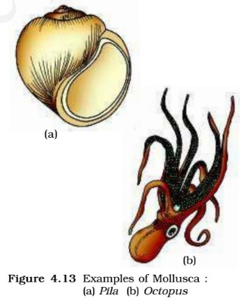

Slide 4
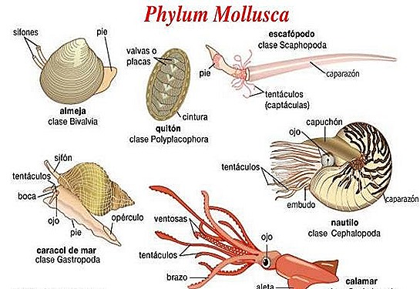

Slide 5
Phylum – Echinodermata
These animals have an endoskeleton of calcareous ossicles [calcium carbonate structures] and, hence, the name Echinodermata (spiny skinned organisms).
They are exclusively free-living marine animals with organ-system level of organisation.
They are triploblastic with a coelomic cavity [coelomate animals]. The adult echinoderms are radially symmetrical but larvae are bilaterally symmetrical.

Slide 6
Water-driven tube system [water vascular system] are used for locomotion, capture and transport of food and respiration.
They are triploblastic and coelomate animals.
Digestive system is complete. An excretory system is absent.
Sexes are separate. Reproduction is sexual. Fertilisation is usually external.
Development is indirect with free-swimming larva.
Examples: Star fish, Sea urchin, Sea lily, Sea cucumber, Brittle star

Slide 7
